Slide 1
E R Diagram

Slide 2
Entity-Relationship Model
used for conceptual data modeling
developed by Peter Chen in 1976
made up of entities, relationships, and attributes

Slide 3
Entities
What is an entity?
person, place, object, event, or concept about which an organization (or users) want to maintain data about (or track)
Examples:
Person: EMPLOYEE, STUDENT, PATIENT
Place: STATE, REGION, COUNTRY
Object: MACHINE, BUILDING, AUTOMOBILE
Event: SALE, REGISTRATION, RENEWAL
Concept: ACCOUNT, COURSE, WORK CENTER

Slide 4
Attributes
Properties of an entity are attributes.
Attributes tell the characteristics of that entity.
Every entity has at least one attribute
Example →
Student entity has the rollno, name attributes.
Customer entity has custid, qty, date_of_transaction attributes.

Slide 5
Relationships
are an association between instances of one or more entity types of interest to the organization
One-to-one (1:1)
One-to-many (1:M)
Many-to-many (M:N)

Slide 6
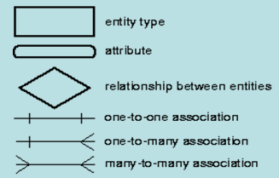
ER Notations

Slide 7
One-to-One relationship
described as 1:1
a single-entity instance of one entity type is related to a single entity instance of another type
primary key of one would be foreign key in the other

Slide 8
One-to-One Relationship
Employee
is assigned to
Office
Every employee is assigned to exactly one office and every office is assigned one employee. (i.e. In the office entity the same employees information will come only once)

Slide 9
One-to-Many relationship
described as 1:M
a single instance of one entity related to many instances of another entity
parent-child relationship
parent is the one side (primary table)
child is the many side (related table)
place key of parent table in child table

Slide 10
One to Many Relationship
Total participation at both the ends.
E.g. One Faculty associated with many students
One Faculty
Students
teaches

Slide 11
One to Many Relationship
Total participation at one end and partial participation at the other end.
An System Analyst may be in charge of many projects (or may not be in charge of any) and every project has exactly one systems analyst in charge.
System Analyst
Projects
Is in charge of

Slide 12
Many-to-Many relationship
described as M:N
many instances of one entity relate to many instances of another entity
must be separated into additional 1:M relations

Slide 13
Many to Many Relationship E.g.1
Salesperson
is assigned to call on
Customer
Every salesperson is assigned to call on one or more customers, and every customer has one or more salespersons assigned to call.

Slide 14
Many to Many Relationship E.g.2
Users
Have
Permissions
An user will have one or multiple permissions.
At the same time a single permission could be given to multiple users!!

Slide 15
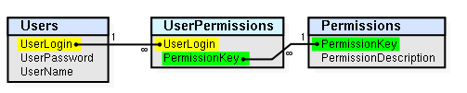
Link Table/ Junction Table / Bridge Table / Associative Table
Junction/Link/Bridge/Associative table is used when dealing with many-to-many relationships in a database.
J / L / B / A Table
Date_of_Permissiont
Assigned_Byt
Reason t

